Slide 1

Facial Key points Detection
Python Project
TEAM 3
Dhairya Chandra
Tanvi Jain
Ashish Pant
Shufeng Li

Slide 2
Introduction
The objective of this task is to predict key point positions on face images. This can be used as a building block in several applications, such as:
tracking faces in images and video
analyzing facial expressions
detecting dysmorphic facial signs for medical diagnosis
biometrics / face recognition Detecting facial key points is a very challenging problem. Facial features vary greatly from one individual to another, and even for a single individual, there is a large amount of variation due to 3D pose, size, position, viewing angle, and illumination conditions.

Slide 3
Dataset – Facial Key points Detection
Kaggle Dataset: https://www.kaggle.com/c/facial-keypoints-detection
The dataset contains images of faces of people in different angles and we have 15 points on the face. There are three points for each eye, two for each eyebrow, one for tip of the nose and 4 for lips. The CSV file has data as (x,y) coordinates on the image. The image data is also stored into the CSV file and sized at 94*94pixel.
Here are the 15 keypoints we have in our dataset:
left_eye_center, right_eye_center, left_eye_inner_corner, left_eye_outer_corner, right_eye_inner_corner, right_eye_outer_corner, left_eyebrow_inner_end, left_eyebrow_outer_end, right_eyebrow_inner_end, right_eyebrow_outer_end, nose_tip, mouth_left_corner, mouth_right_corner, mouth_center_top_lip, mouth_center_bottom_lip

Slide 4
Increment 2
First we have loaded the data set CSV file as pandas data frame. As the dataset contains null values, currently we are removing those images from the loaded data.
Then we have split the data into two parts: keypoints and image pixels
Then we have reshaped the image to height = 96px width = 96px and then scaled the data
In end we have plotted the first image and its facial points

Slide 5
Increment 2 – Predictions on trained model

Slide 6
Final Increment - Added Augmentation
Shifting the image
Flipping the image
Rotating the image
Adding Noise

Slide 7
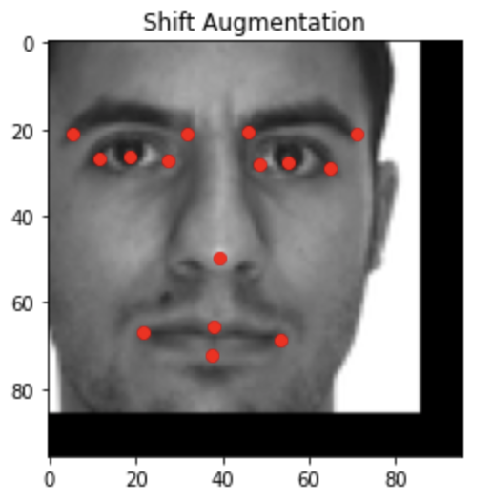
Shifting the image

Slide 8
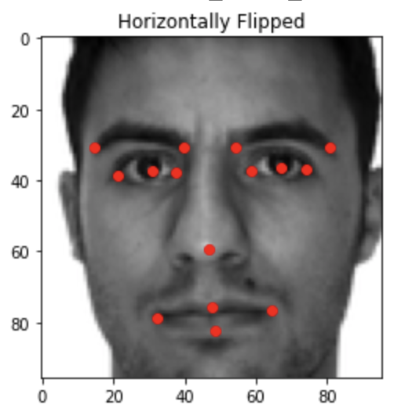
Flipping the image

Slide 9
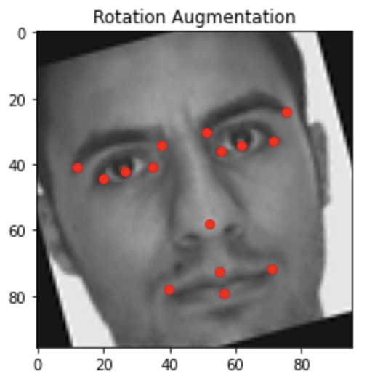
Rotating the image

Slide 10
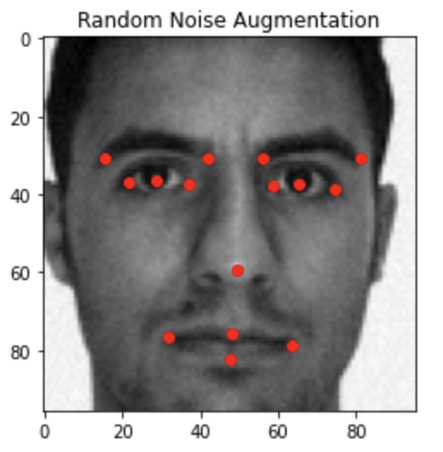
Adding Noise to the image

Slide 11
Final Graphs

Slide 12
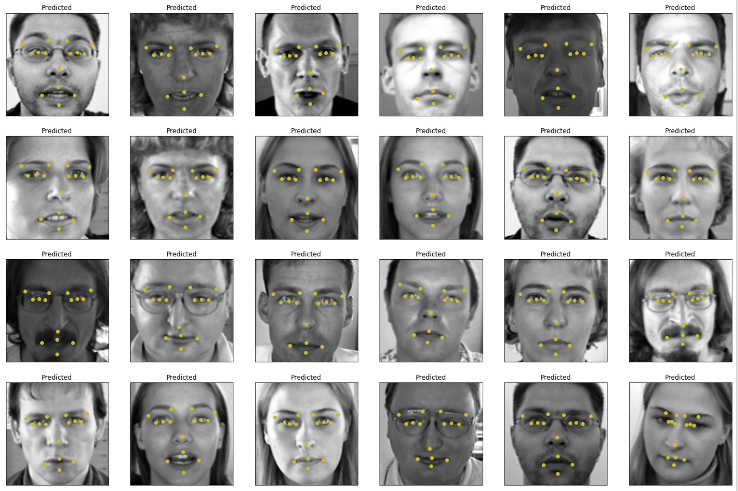
Final Result – Test Dataset

Slide 13
Final Result – Our Images

Slide 14
Future Work
This can be used for detecting faces on AR apps like snapchat
To detect expressions of people
Security system where facial key points will be detected

